Slide 1
Music, Music Representation,
AND
Music Retrieval
Donald Byrd
Center for Research on Concepts & Cognition
Indiana University Bloomington
20 April 2023
(rev. 10 May 2023)
Notes:
• My daughter was born in Princeton, so it’s a special pleasure to be here.
• I started out to be a composer, so got intense education in music of the “classical” tradition, before discovering computers. My collaborators and I received the 1st major grant for music-IR research (1999), and that led to the 1st international conference on music IR, of which I was general chair.

Slide 2
Motivation: Audio-to-Audio Music Retrieval
Shazam (Wang, 2003): “just hit 2580 on your mobile phone and identify music”
  Query:
  Match:
Have they solved all the problems of music IR? No, (almost) none!
Reason: desired signal & match are identical => no time warping, let alone higher-level problems (perception/cognition)
Notes:
This is kind of a preview; I’ll come back to this example.

Slide 3
Overview
I‘ll mostly avoid details of current technology & focus on underlying principles
Organization of the talk
  I. Music Is An Art. What Else Is It?
  II. Music Representation: Audio, Events, Notation
  III. Music Retrieval
  IV. Conclusions
Interrupt with burning questions; please save non-burning ones
Notes:
Focus on principles so what I cover will be maximally applicable: info like this isn’t widely known

Slide 4
You Are Here
  I. Music Is An Art. What Else Is It?
II. Music Representation: Audio, Events, Notation
III. Music Retrieval
IV. Conclusions

Slide 5

Music Is An Art
Music is an art
=> numerous works use the same elements, but very often in novel ways
Example: string quartet in “Eleanor Rigby”
Example: Ives’ Concord Sonata quotes Beethoven’s 5th
Example in visual art: Chagall story
Text analogy: Music is more like poetry than prose
Notes:
There’s a story that Marc Chagall said, in response to criticism of his drawing by an art critic, “Of course I draw poorly. I like to draw poorly.” That is, in his art, Chagall had no intention of using the element of drawing the way it was ordinarily used.

Slide 6
Music Is A Performing Art
Music is a performing art
=> a performance is rarely the work itself
It’s one of numerous possible instantiations of the work
  Audio: “Yesterday” has been covered over 3,000 times
  Notation: at least eight editions of Mozart Piano Sonatas published by 1956
Text analogy: play in verse
Exception: Jimi Hendrix’s “Star-Spangled Banner” improvisation at Woodstock. Two excerpts:
Exception: “electronic” music

Slide 7
Music May or May Not Be Representational 1
Music can be totally nonrepresentational
=> everything can be abstract: need not focus on anything from the real world
Instrumental music is rarely representational
...but it can refer to other music
  Meaning unclear
    Ex.: Ives’ Concord Sonata quoting Beethoven’s 5th
  Meaning pretty clear!
    Ex.: Berlioz: Symphonie Fantastique, V (“Witches’ Sabbath”) quotes the Gregorian chant “Dies Irae” (“Day of Wrath”, i.e., Judgment Day)

Slide 8
Music May or May Not Be Representational 2
Vocal music is different
...but not completely, since lyrics are often poetry!
Movie music is different for obvious reason
Cf. denotation vs. connotation in semantics (later in this talk)

Slide 9
Music Is An Art, and...
Most music, especially Western art-tradition music, has independent “voices” (melodic lines)
  Unlike text, it’s fundamentally 2-dimensional!
Music involves many different instruments
  including human voices, of course
=> “numerous possible instantiations” can be for other ensembles or at other levels of difficulty
...especially for music in notation form
  Example: Beethoven’s Fifth Symphony published in arrangements for at least nine different ensembles
  “Easy” versions of pieces are common

Slide 10
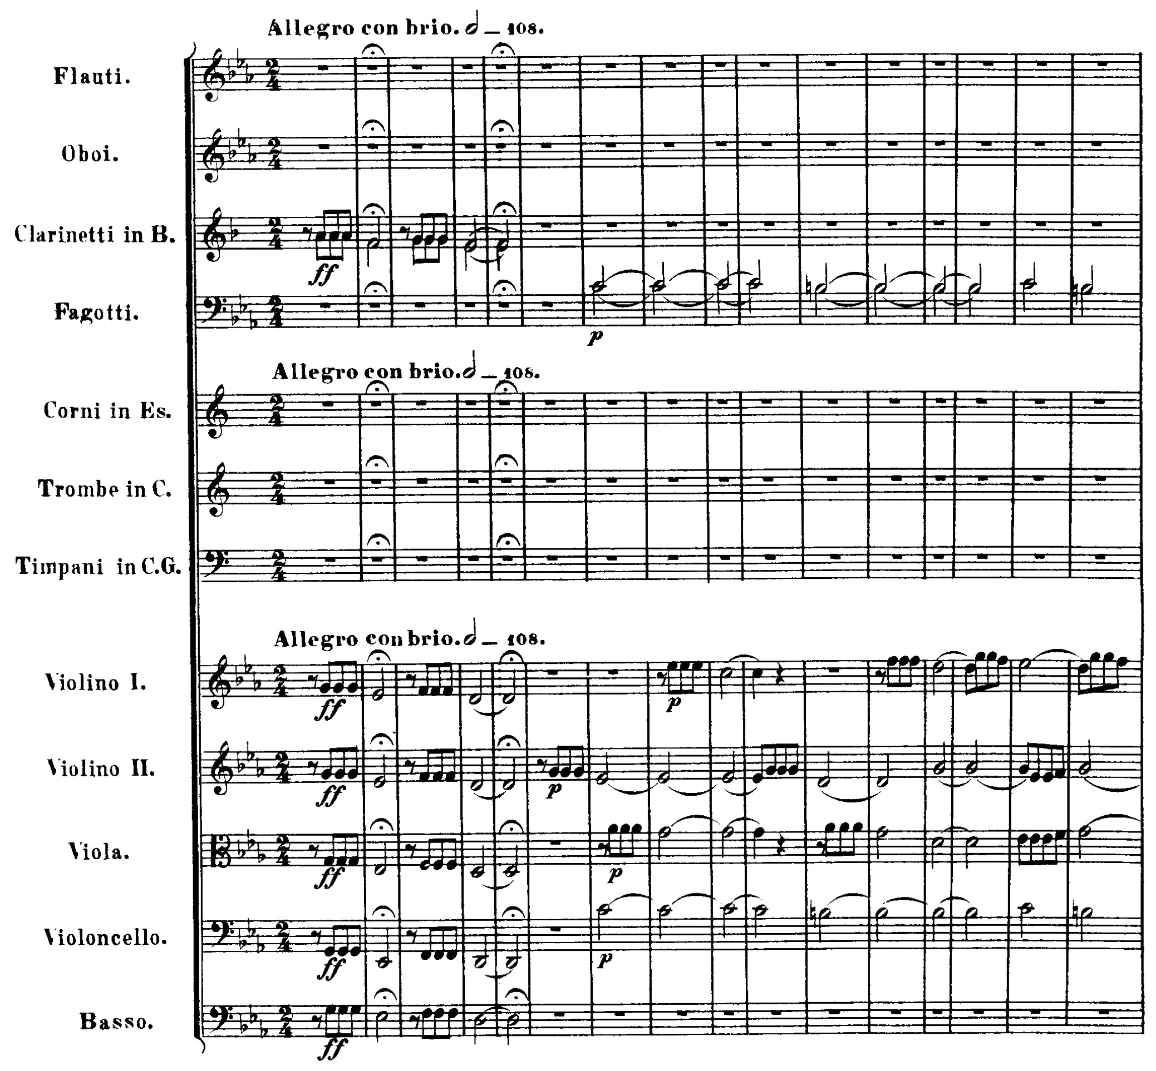
Independent Voices in Music
Beethoven: Symphony no.5, I, beginning

Slide 11
Independent Voices in Text
MARLENE. What I fancy is a rare steak. Gret?
ISABELLA. I am of course a member of the / Church of England.*
GRET. Potatoes.
MARLENE. *I haven’t been to church for years. / I like Christmas carols.
ISABELLA. Good works matter more than church attendance.
  --Caryl Churchill: “Top Girls” (1982), Act 1, Scene 1
Performance (time goes from left to right):
M: What I fancy is a rare steak. Gret? I haven’t been...
I: I am of course a member of the Church of England.
G: Potatoes.

Slide 12
You Are Here
I. Music Is An Art. What Else Is It?
II. Music Representation: Audio, Events, Notation
III. Music Retrieval
IV. Conclusions

Slide 13
Basic Representations of Music
Basic representations, with text analogs:
Audio (e.g., CD, MP3): like recording of speech
Time-stamped Events (e.g., MIDI file): like unformatted text
Music Notation (e.g., “Conventional”): like HTML or RTF text
Essential difference: explicit structure

Slide 14
Basic Representations of Music
MIDI = Musical Instrument Digital Interface: simple, standard low-bandwidth protocol from 1980’s
Audio Time-stamped Events Music Notation
Common examples CD, MP3 file Standard MIDI File CMN sheet music
Unit Sample Event Note, clef, lyric, etc.
Explicit structure none some (partial voicing much (complete
information) voicing information)
Convert to form with less explicit structure (to left): moderately hard to do well
Convert to form with more explicit structure (to right): very hard to do well

Slide 15
From Representation to Notation
A notation is a visualization of a representation
Choosing a representation inevitably introduces bias
Choosing notation for it inevitably introduces more bias
For huge body of important music, we have no choice: notation is CMN (Conventional Music Notation)!
  Really “CWMN” (W = Western)
  Alternative for some music: tablature (guitar, lute, etc.)
  CMN is among the most successful notations ever
  …but also among the most complex and subtle

Slide 16
Music Notation vs. Math and Chinese
  Don’s dissertation: CMN more complex/subtle than mathematical notation or Chinese
    Typographic complexity, is relevant, not syntactic or semantic
Chinese has a heck of a character set, but you just put the characters down in rows as with other languages
Mathematical notation is a more serious opponent, but CMN is necessarily more complex because of constraints:
  Music must be read in real time => as efficient as possible: “Omit Needless Symbols”
  Ability to sight read music is important => no “macros”
  Musician’s hands are full => minimize page turns
Notes:
• CMN is used in 99% of “European art tradition” music & a lot of other music since 1700 or earlier.
• Chinese writing is trivial in comparison with music: it’s just like writing in other languages, but with an enormous character set. Math is much harder, but still simpler than CMN

Slide 17
How to Read Music Without Really Trying 1
Basic parameters of a musical note
  1. Pitch: how high or low sound is
  2. Duration: how long the note lasts
  3. Loudness: perceptual analog of amplitude
  4. Timbre or tone quality
Above in decreasing order of importance for most Western music

Slide 18

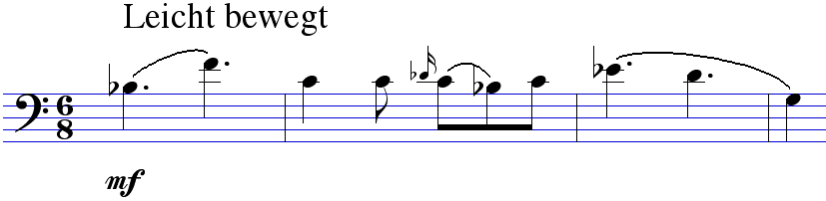
How to Read Music Without Really Trying 2
Principles of CMN
  1. Pitch on Y axis: clef gives offset (“origin”)
  2a. Relative duration indicated by note/rest shapes
  2b. Start times (sum of durations in the voice) on X axis
  3. Loudness indicated by signs like p , mf , etc.
  4. Timbre indicated with words like “violin”, “horn”, “pizzicato”
But what if something changes during a note?

Slide 19
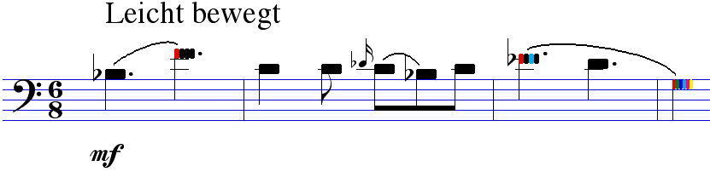
Adding to Notation Detail from Audio
CMN bias: no way to show what happens during a note (with very limited exceptions)
...but it can be extended, e.g., with “notehead graphs”
From an experimental version of Nightingale:
Colors intended to show deviations from correct pitch
...but could show changes in loudness, tone quality, etc.
Notes:
• Nightingale is a music-score editor I designed; was a commercial product from 1993 to early 2000’s; an artistic success but a commercial failure. Now open source, on GitHub
• Music is the Hindemith Bassoon Sonata

Slide 20
You Are Here
I. Music Is An Art. What Else Is It?
II. Music Representation: Audio, Events, Notation
III. Music Retrieval
IV. Conclusions

Slide 21
Audio-to-Audio Music Retrieval: No Explicit Structure Needed
Shazam (Wang, 2003): “just hit 2580 on your mobile phone and identify music”
  Query:
  Match:
Have they solved all the problems of music IR? No, (almost) none!
Reason: desired signal & match are identical => no time warping, let alone higher-level problems (perception/cognition)
Notes:
Task is Similarity Scale category #1

Slide 22

Similarity Scale for Content-Based Music IR
Categories describe what’s in common between query and items in corpus being searched (closest to most distant)
  NB: If in notation form, performance & recording don’t apply.
1. Same music, arrangement, performance, & recording (Shazam)
2. Same music, arrangement, performance; different recording (Dead)
3. Same music, arrangement; different performance, recording (OMRAS)
4. Same music, different arrangement; or different but closely-related music, e.g., simpler variations (Mozart “Twinkle” Variations, etc.), many covers, minor revs. (mainstream early music IR research)
5. Different & less closely-related music: freer variations (Brahms, jazz, etc.) , extensive revisions, wilder covers (Hendrix in Part I) (AI/Spotify)
6. Music in same genre, etc. (AI; Spotify?)
7. Music influenced by other music (AGI; GPT-5 or -6 or X?)
Notes:
PLAY SOME TWINKLE VARIATIONS
• Time warping needed from #2 on; perception/cognition more & more from #3 on
• “Dead” = Grateful Dead concerts; for many, there are many recordings.
“OMRAS” = OMRAS music-IR project (next slide)

Slide 23
OMRAS Polyphonic Audio Music IR: Requires Event Representation
Ca. 2004; started with recordings of Bach preludes & fugues
Did polyphonic (several notes at once) music recognition to convert to events
  Converted results to MIDI & used as queries against database of ca. 3000 pieces in MIDI form
  Example: one of worst-sounding cases: Prelude in G Major from Well-Tempered Clavier, Book I
  Outcome: the actual piece was ranked 1st
Models built from notation database, but note data only
Query (audio -> MIDI)
Match (original audio recording)
Notes:
Task is Similarity Scale category #3.5: “Same music, arrangement; different performance, recording”, but with MANY mistakes in query performance

Slide 24
Music-IR Problems that Need More Structure
Joan Public’s problem: find a song, given some of the melody and some lyrics
  Needs notes and text (lyrics)
  Common question for music librarians (formerly?)
Jean Public’s problem: find music they’re likely to like, given examples of music they do like
Music scholar’s problem: authorship/origin of works in manuscripts
  Full symbolic data is important, even “insignificant” details of notation (John Howard)

Slide 25
Semantics in Music
Meaning = denotation (explicit, well-defined)
...plus connotation (implicit, ill-defined)
In text:
  Two “definitions” of pig:
    1. Mammal with short legs, cloven hoofs, bristly hair, and a cartilaginous snout used for digging (dictionary)
    2. Ugh! Dirty, evil-smelling creatures, wallowing in filthy sties! (Hayakawa & Hayakawa example)
  Prose is mostly denotation
  Poetry is art => connotation much more important
Music is always art, & almost all connotation!
Notes:
Dictionary: American Heritage
Book by Hayakawa & Hayakawa, Language in Thought & Action

Slide 26
Why is Musical Information Hard to Handle?
Polyphony: “parallel” independent voices, something like characters in a play (all representations)
  “Music is fundamentally 2-dimensional”
Connotations are always important (all representations)
Recognizing notes (audio only)
Units of meaning: not clear anything is analogous to words (all representations—NEW TO US )
Melodic similarity (all representations—NEW)
Notes:
We’ve already talked about #1, 2, and #3

Slide 27
Problem 4: Units of Meaning
Not clear anything in music is analogous to words
  No explicit delimiters (like Chinese)
  Experts don’t agree on “word” boundaries (unlike Chinese)
Are notes like words?
No. Relative, not absolute, pitch is important
Are pitch intervals like words?
No. They’re too low level: more like characters
Are pitch-interval sequences like words?
In some ways, but
  Ignores note durations
  Ignores relationships between voices (harmony)

Slide 28
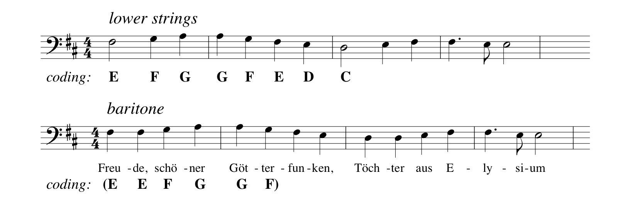
Problem 5: Melodic Similarity 1
Evaluating similarity of versions of a melody isn’t easy
Minor (to our ears) differences may not be to a computer
Easy example: repeated notes (Beethoven, Symphony no. 9, IV, “Ode to Joy” theme)
  Version on top is how it first appears
  Version on bottom is the familiar melody

Slide 29
Problem 5: Melodic Similarity 2
Minor (to our ears) differences may not be to a computer
  Approximate string matching, e.g., Levenshtein distance?
  Fine for the repeated-note example, but isn’t ideal
Harder example: B is an “ornamented” version of A
  In general, “Earth Mover’s Distance” is much better
  Why? “Music is fundamentally 2-dimensional”!

Slide 30
You Are Here
I. Music Is An Art. What Else Is It?
II. Music Representation: Audio, Events, Notation
III. Music Retrieval
IV. Conclusions & “By the Way”

Slide 31
Conclusions: Review
  Music Is An Art. What Else Is It?
    It’s a performing art
    It’s fundamentally nonrepresentational
    It involves many different instruments
    It’s polyphonic
  II. Music Representation: Audio, Events, Notation
    Essential difference: explicit structure
    Audio: none; time-stamped events: some; notation (CMN): lots
    Principles of CMN
  III. Music Retrieval
  Representations express Semantics
  Semantics of Music; Denotation & Connotation
  Why Musical Information Is Hard to Handle: 4 reasons

Slide 32
Conclusions: Why Is This Important?
Some problems directly related to other areas of informatics
  Example: Approximate string matching in bioinformatics
Handling music is really hard
  GPT-4’s “compositions” are mediocre; its attempts to improve them based on human feedback are usually unsuccessful (Eric Nichols)
Encourages progress on real semantics
  Connotation is an important part of meaning in everything
  Can often be ignored, but not in arts
  Music is probably more quantifiable than other arts, so likely more tractable
    Evidence: compare music theory to theory of other arts
Notes:
• Evidence music is more quantifiable: compare music theory to theory of art, literature, etc.
• GPT-4 etc. raise questions about a lot of what I’ve said!

Slide 33
By the way, why does music in minor sound more serious than in major?
Bob Krovetz’s question (rephrased): Music in minor sounds more serious, even less “happy”, than in major. Why?
I don’t know, but here’s a plausible speculation:
  The tonic triad in C minor consists of C, E-flat, and G
  ...but the 5th harmonic of C is E-natural
  Sounds of almost all acoustic instruments contain harmonics to the 5th and beyond
  Interval from E-flat to E is a sharp dissonance
    Technically, an augmented unison, but = minor 2nd
  Q.E.D.? What do music psychologists say about it?
Notes:
• Evidence music is more quantifiable: compare music theory to theory of art, literature, etc.
• GPT-4 etc. raise questions about a lot of what I’ve said tonight!

Slide 34
You Are Here
The End
References
Avian Music Notation Foundation. Nightingale. https://github.com/AMNS/Nightingale
Byrd, D. (1984). Music Notation by Computer (doctoral dissertation, Computer Science Dept., Indiana University). https://homes.luddy.indiana.edu/donbyrd/Papers/DonDissScanned.pdf
Byrd, D., & Crawford, T. (2002). Problems of Music Information Retrieval in the Real World. Information Processing and Management 38, pp. 249–272.
Hayakawa, S.I., & Hayakawa, A.R. (1991). Language in Thought and Action, 5th ed. Harvest.
Nichols, E. (2023). Personal communication.
Pickens, J., Bello, J.P., Crawford, T., Dovey, M., Monti, G., Sandler, M.B., & Byrd, D. (2002). Polyphonic Score Retrieval Using Polyphonic Audio Queries: A Harmonic Modeling Approach. In Proceedings of the 3rd Int’l Conference on Music IR (ISMIR 2002), Paris, France, pp. 140–149.
Wang, A. (2003). An Industrial Strength Audio Search Algorithm. In Proceedings of the 4th Int’l Conference on Music IR (ISMIR 2003), Baltimore, MD

